Slide 1

FROM JUMPS TO SIGNALS:
SELECTING CMJ METRICS FOR INJURY-RISK CLASSIFICATION
Early Results Presentation

Slide 2

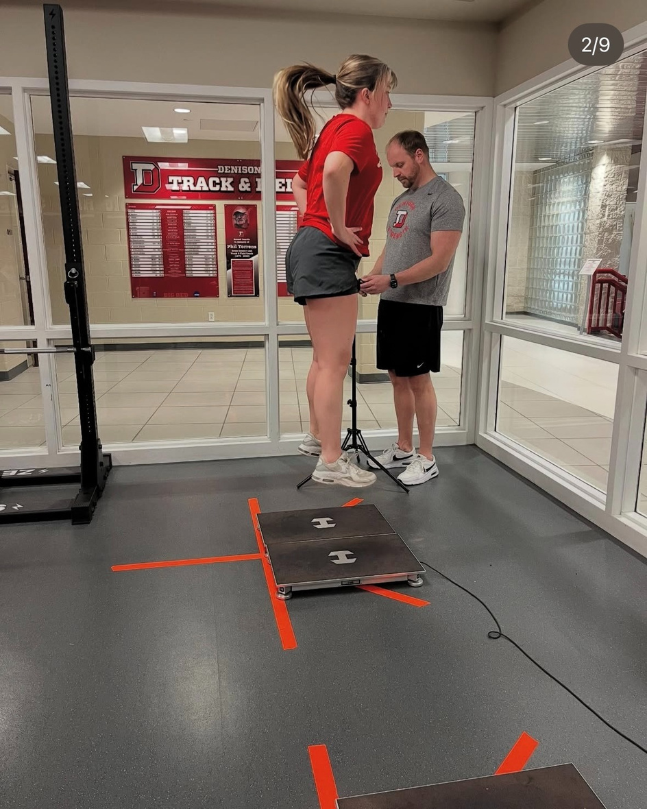
BACKGROUND
The countermovement jump (CMJ) is a vertical jump that involves a downward movement (countermovement) before an upward leap (Walker, 2025).
A force plate is an instrument that allows coaches to detect and measure the force that is produced during physical exercises like the CMJ (Hawkin Dynamics, 2021).
COUNTERMOVEMENT JUMP ⟶
At Denison, our Strength and Conditioning Department uses the force plates to track changes in performance and fatigue in our athletes. Yet, not much is known about how we can use the force plates to track injury prevention.
FORCE PLATE ⟶
@denisonstrength on Instagram

Slide 3

WHICH SUBSET OF CMJ FORCE PLATE METRICS ARE MOST INFORMATIVE FOR CLASSIFYING INJURY-RISK IN ATHLETES?

Slide 4

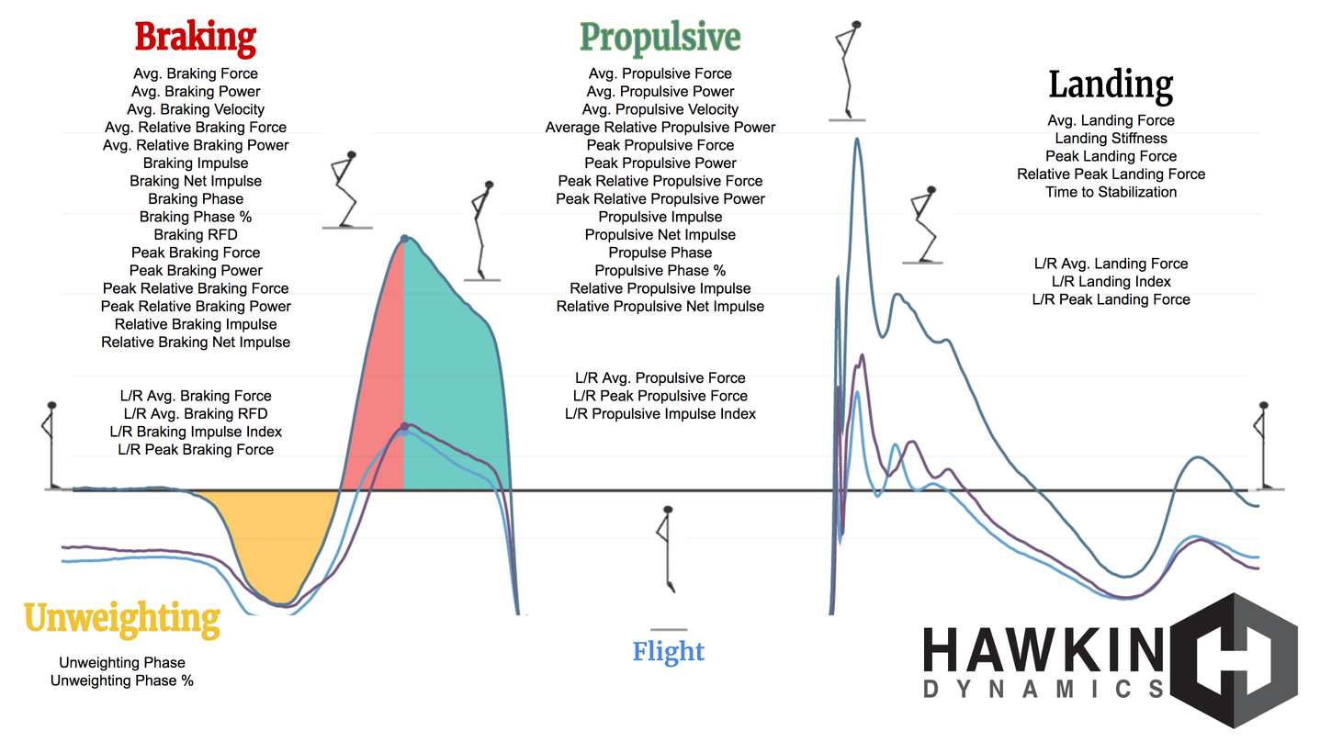
ABOUT THE DATA
(2024-2025 Academic Year)
Force Plate Data
1
311 variables with over 20,000 observations
70+ metrics from one CMJ
Injury Data
8 datasets combined and cleaned into 1 dataset with 8 variables and 275 observations
filtered to exclude injuries or illnesses that the force plate may not predict (pneumonia, influenza, insect bites, etc.)
2
Combined Data
(Hawkin Dynamics, 2021)
3
created “Injured” variable where =1 if a jump occured at least 4 weeks prior to a recorded injury
only 6% of the jumps are “Injured”

Slide 5

THE ORIGINAL PLAN
Because of the complexity of the data, we wanted to split our analysis into two pieces:
FEATURE SELECTION
&
PREDICTION
Elastic Net Regularization
Variance Inflation Factors
Resampling Method
Extreme Gradient Boosting (XGBoosting)
This would allow us to predict injury-risk with the smallest possible subset of CMJ metrics.

Slide 6
HERE’S HOW IT’S BEEN GOING

Slide 7

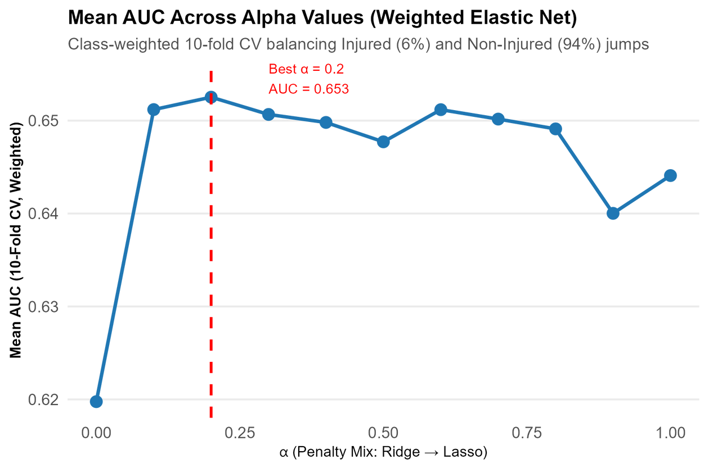
ELASTIC NET
RESULTS
To address the imbalance between injured and non-injured jumps, class weights were applied so both groups contributed equally during training.
When performing cross-validation, the optimal alpha value using the mean AUC was 0.2 ⟶ which is practically just Ridge.
While this accounts for multicollinearity, there was no variable selection.
We still have 73 predictors of injury-risk after performing Elastic Net. This does not help us determine the best subset of predictors.
Notes:
Updated title: “Weighted elastic net regularization yielded an alpha penalty mix most reflective of Ridge regularization”
Caption: Figure 1 displays weighted Elastic Net 10-fold cross-validation using Mean AUC as the criterion for selecting the optimal alpha value. The results favored Ridge regularization, indicating zero variable selection.

Slide 8
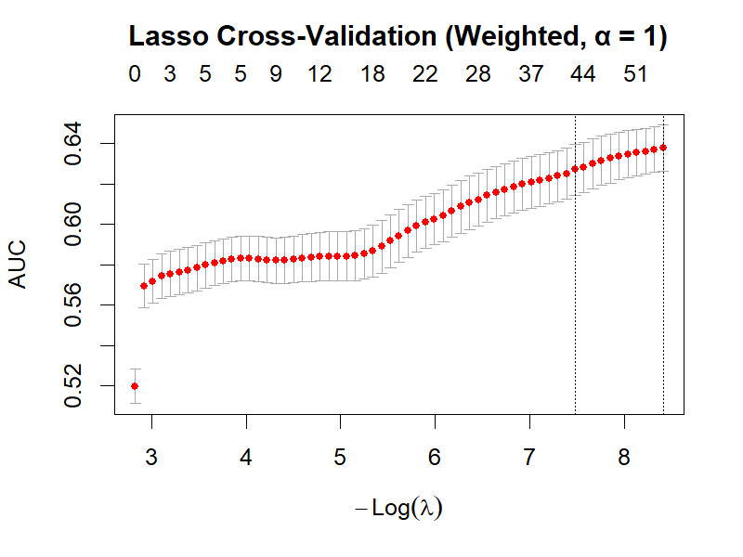
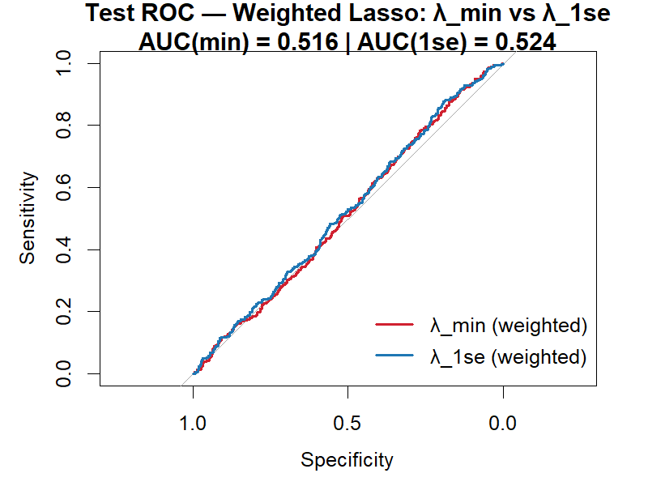
LASSO
Cross-validation identified λ_min = 0.00022 and λ₁se = 0.00056. The performance steadily improved as λ decreased, peaking around an AUC of 0.64. The small gap between the two λ values suggests that the simpler λ₁se model achieves nearly equivalent performance while using fewer predictors. (left)
RESULTS
To perform feature selection, we applied Lasso classification with class weighting to balance injured and non-injured jumps during training.
Unlike Elastic Net, this approach reduced the model to 43 predictors of injury risk.
The ROC curves compare model discrimination on the test set. Both λ_min and λ₁se models achieved AUC values slightly above 0.5, meaning their ability to distinguish injured from non-injured jumps was only marginally better than random. The red and blue curves hug the diagonal, confirming limited predictive power of linear models on this dataset. (right)
This came at the cost of lower predictive accuracy in linear models.

Slide 9

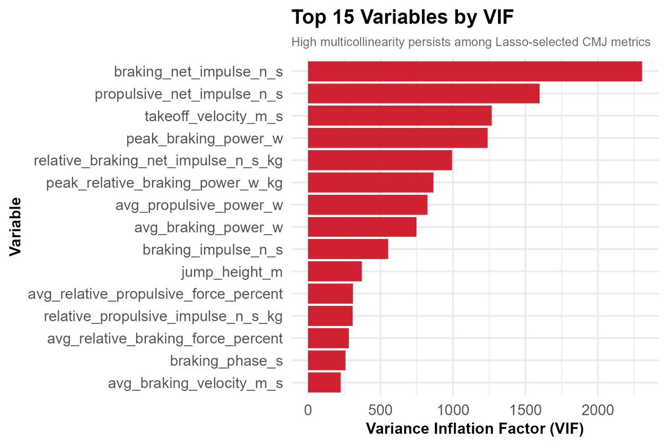
VARIANCE INFLATION FACTORS (VIFS)
To check multicollinearity among the 43 Lasso predictors, we computed Variance Inflation Factors (VIFs) where values above 10 indicate severe multicollinearity (James et al., 2021, p. 102).
After Lasso, several metrics, like braking net impulse and propulsive net impulse, remained highly correlated with VIFs above 1000. The median VIF was 72.3, confirming persistent redundancy among CMJ features. This suggests a linear model may not capture the structure of the data.

Slide 10
WHAT’S NEXT?

Slide 11
PREDICTION WITH
Handle Class Imbalance
1
XGBOOSTING
We will first address imbalance using XGBoost’s built-in scale_pos_weight parameter to upweight injured jumps (xgboost developers, 2025).
If performance remains poor, we’ll implement a bagging approach to further balance the data (Lövdal et al., 2021).
While Lasso reduced the model to 43 predictors, linear performance remained weak (AUC 0.52), suggesting that injury risk likely depends on non-linear interactions that linear models cannot capture.
Build the Model
2
Train an XGBoost classifier using the 43 Lasso-selected features,
Additionally, our VIF results confirmed that many predictors remain highly correlated.
Evaluate & Interpret
The next step applies XGBoost, a tree-based method designed to handle both nonlinearity and multicollinearity more effectively (Chen & Guestrin, 2016; Pham & Ho, 2021).
Use cross-validation to optimize parameters (learning rate, depth, trees)
Assess AUC, precision, and F1 score and apply SHAP values to identify key predictors influence injury risk
3
Notes:
Well, I could continue to pursue XGBoosting because it’s a tree-based method designed to handle both nonlinearity and multicollinearity. But, I’m still concerned about moving forward with predictive modeling because of the strong multicollinearity and small predictive power.
I think some of this predictive power may be counteracted before XGBoosting after applying an actual resampling technique, like bagging rather than relying on just reweighting, but I want to make sure that I don’t move forward without proper handling of the variables.
So, while this was the originally planned next step, I want to make sure it still applies to my dataset after getting results from Lasso and VIF before continuing with my modeling.
For now, I’m at a bit of a standstill, but I’m open to any suggestions moving forward and look forward to meeting with Dr. Wang later this week.

Slide 12
REFERENCES
Chen, T., & Guestrin, C. (2016). XGBoost: A scalable tree boosting system. In Proceedings of the 22nd ACM SIGKDD International Conference on Knowledge Discovery and Data Mining (pp. 785–794). Association for Computing Machinery.
Hawkin Dynamics. (2021, August). The countermovement jump playbook (eBook v1). Hawkin Dynamics.
James, G., Witten, D., Hastie, T., & Tibshirani, R. (2021). An introduction to statistical learning: With applications in R (2nd ed.). Springer.
Lövdal, S., den Hartigh, R., & Azzopardi, G. (2021). Injury Prediction in Competitive Runners with Machine Learning. International journal of sports physiology and performance, 16(10), 1522–1531.
Pham, X. T. T., & Ho, T. H. (2021). Using boosting algorithms to predict bank failure: An untold story. International Review of Economics & Finance, 76, 40–54.
Walker, O. (2025, March 17). Countermovement jump (CMJ). Science for Sport. https://www.scienceforsport.com/countermovement-jump-cmj/

